Slide 1
Graph ADT

Slide 2
Topics to be Discuss
Basic Definitions and Graph Representation issues
Graph Traversal
Breadth-First Search(BFS)
Depth-First Search(DFS)
Topological Sorting
Strongly Connected Components
Transitive Closure
Single Source shortest paths: Dijkstra’s Algo
All-pairs shortest paths: Floyd-Warshall’s Algo
Minimum Spanning Tree:Prim’s &Kruskal’s Algo
CS C363/IS C363

Slide 3
What is a Graph?
A graph G = (V,E) is composed of:
V: set of vertices
E: set of edges connecting the vertices in V
An edge e = (u,v) is a pair of vertices
Example:
a
b
V= {a,b,c,d,e}
E= {(a,b),(a,c),(a,d),
(b,e),(c,d),(c,e),
(d,e)}
c
d
e
CS C363/IS C363

Slide 4
Terminology:
Adjacent and Incident
If (v0, v1) is an edge in an undirected graph,
  v0 and v1 are adjacent
  The edge (v0, v1) is incident on vertices v0 and v1
If <v0, v1> is an edge in a directed graph
  v0 is adjacent to v1, and v1 is adjacent from v0
  The edge <v0, v1> is incident on v0 and v1
CS C363/IS C363

Slide 5
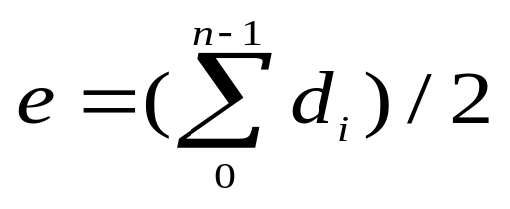

Terminology:Degree of a Vertex
The degree of a vertex is the number of edges incident to that vertex
For directed graph,
  the in-degree of a vertex v is the number of edges
  that have v as the head
  the out-degree of a vertex v is the number of edges
  that have v as the tail
  if di is the degree of a vertex i in a graph G with n vertices and e edges, the number of edges is
Why? Since adjacent vertices each
count the adjoining edge, it will be
counted twice
CS C363/IS C363

Slide 6
Examples
0
3
2
0
1
2
3
3
3
1
2
3
3
4
5
6
G1
1
3
1
G2
1
1
3
0
in:1, out: 1
directed graph
in-degree
out-degree
1
in: 1, out: 2
2
in: 1, out: 0
G3
CS C363/IS C363

Slide 7
Terminology:Path
path: sequence of vertices v₁,v₂,. . .v_{k} such that consecutive vertices v_{i} and v_{i+1} are adjacent.
1
2
5
4
3
a
b
a
b
c
c
d
e
d
e
a b e d c
b e d c
CS C363/IS C363

Slide 8
More Terminology
simple path: no repeated vertices
cycle: simple path, except that the last vertex is the same as the first vertex
Example: a c d a
A cycle is simple if each vertex in the path is distinct, except for the
first and last one.
A directed path is a path such that all the edges are directed and are
traversed along their direction.
a
b
b e c
c
d
e
CS C363/IS C363

Slide 9
Even More Terminology
connected graph: any two vertices are connected by some path
connected
not connected
subgraph: subset of vertices and edges forming a graph
A spanning subgraph of G is a subgraph of G that contains all the vertices of G.
connected component: maximal connected subgraph. E.g., the graph below has 3 connected components.
CS C363/IS C363

Slide 10
Subgraphs Examples
0
0
0
1
2
0
1
2
1
2
3
1
2
3
G1
(i) (ii) (iii) (iv)
(a) Some of the subgraph of G₁
3
0
0
0
0
0
1
1
1
1
2
2
2
(i) (ii) (iii) (iv)
(b) Some of the subgraph of G₃
G3
CS C363/IS C363

Slide 11
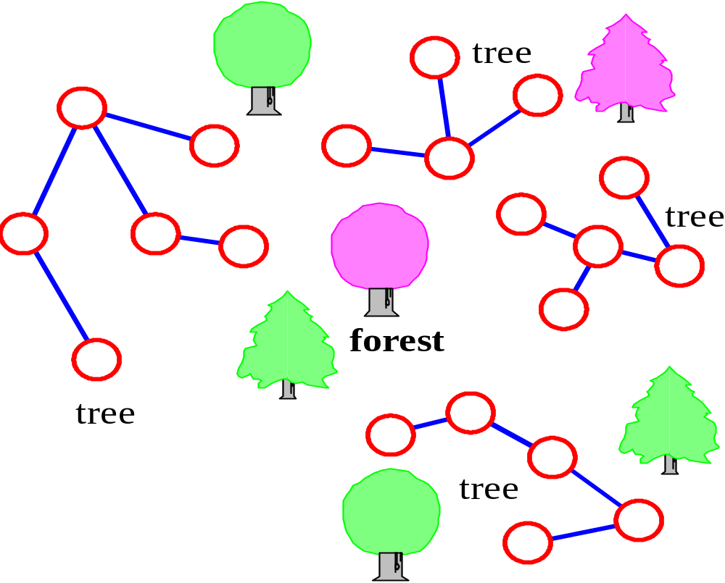
More…
tree - connected graph without cycles
forest - collection of trees
A spanning tree of a graph is a spanning subgraph that is a (free) tree.
CS C363/IS C363

Slide 12
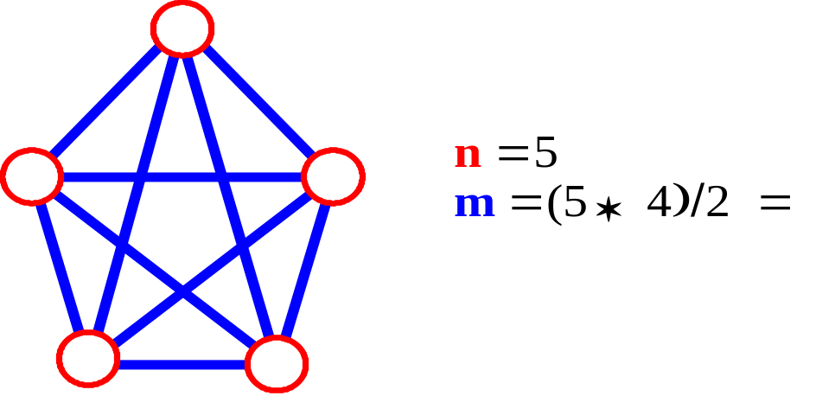
Connectivity
Let n = #vertices, and m = #edges
A complete graph: one in which all pairs of vertices are adjacent
How many total edges in a complete graph?
  Each of the n vertices is incident to n-1 edges, however, we would have counted each edge twice! Therefore, intuitively, m = n(n -1)/2.
Therefore, if a graph is not complete, m < n(n -1)/2
CS C363/IS C363

Slide 13
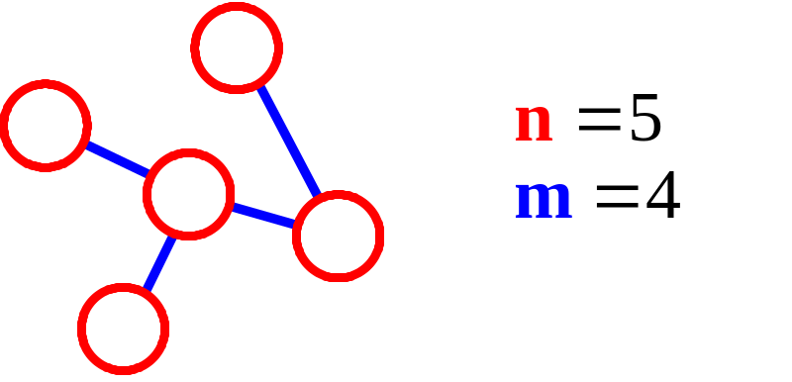
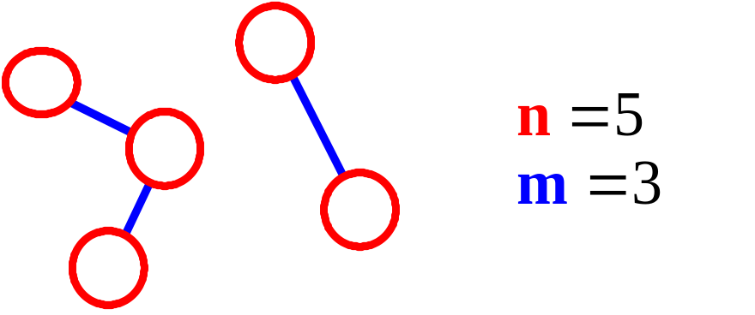
More Connectivity
n = #vertices
m = #edges
For a tree m = n - 1
If m < n - 1, G is not connected
CS C363/IS C363

Slide 14
Oriented (Directed) Graph
A graph where edges are directed
CS C363/IS C363

Slide 15
Directed vs. Undirected Graph
An undirected graph is one in which the pair of vertices in a edge is unordered, (v0, v1) = (v1,v0)
A directed graph is one in which each edge is a directed pair of vertices, <v0, v1> != <v1,v0>
tail
head
CS C363/IS C363

Slide 16
Graph Representations
Adjacency Matrix
Adjacency Lists
CS C363/IS C363

Slide 17
Representation of Graphs
Two standard ways.
  Adjacency Lists.
  Adjacency Matrix.
a
b
a
b
d
c
b
a
c
c
d
c
d
a
b
d
a
c
1
2
1 2 3 4
1 0 1 1 1
2 1 0 1 0
3 1 1 0 1
4 1 0 1 0
a
b
c
d
3
4
CS C363/IS C363

Slide 18
Adjacency Lists
Consists of an array Adj of |V| lists.
One list per vertex.
For u ∈ V, Adj[u] consists of all vertices adjacent to u.
a
b
a
b
d
c
b
c
If weighted, store weights also in adjacency lists.
c
d
c
d
d
a
b
a
b
d
c
b
a
c
c
d
c
d
a
b
d
a
c
CS C363/IS C363

Slide 19
Storage Requirement
For directed graphs:
  Sum of lengths of all adj. lists is
∑out-degree(v) = |E|
^{v∈V}
  Total storage: Θ(V+E)
For undirected graphs:
  Sum of lengths of all adj. lists is
∑degree(v) = 2|E|
^{v∈V}
  Total storage: Θ(V+E)
No. of edges leaving v
No. of edges incident on v. Edge (u,v) is incident on vertices u and v.
CS C363/IS C363

Slide 20
Pros and Cons: adj list
Pros
  Space-efficient, when a graph is sparse(those for which |E| is much lesser than V².
  Can be modified to support many graph variants.
Cons
  Determining if an edge (u, v) ∈G is not efficient.
    Have to search in u’s adjacency list. Θ(degree(u)) time.
    Θ(V) in the worst case.
CS C363/IS C363

Slide 21
Some Operations
degree of a vertex in an undirected graph
  No. of nodes in adjacency list
No. of edges in a graph
  determined in O(n+e)
out-degree of a vertex in a directed graph
  No. of nodes in its adjacency list
in-degree of a vertex in a directed graph
  traverse the whole data structure
CS C363/IS C363

Slide 22
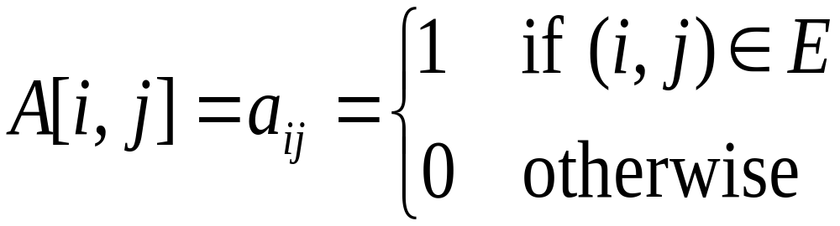
Adjacency Matrix
|V| × |V| matrix A.
A is then given by:
1
2
1 2 3 4
1 0 1 1 1
2 0 0 1 0
3 0 0 0 1
4 0 0 0 0
a
b
c
d
4
3
1
2
1 2 3 4
1 0 1 1 1
2 1 0 1 0
3 1 1 0 1
4 1 0 1 0
a
b
A = A^{T} for undirected graphs.
c
d
3
4
CS C363/IS C363

Slide 23
Space and Time
Space: Θ(V²).
  Not memory efficient for large graphs.
Time: to list all vertices adjacent to u: Θ(V).
Time: to determine if (u, v) ∈ E: Θ(1).
Can store weights instead of bits for weighted graph.
A graph without parallel edges and self loop is called
a simple graph.
An adjacency-matrix representation may preferred when the graph is dense, however, an adjacency-list
is usually preferred when the graph is sparse.
CS C363/IS C363

Slide 24
END

